Slide 1
R
Setting up
R bootcamp -- 2020
Leili Mortazavi -- Includes material adopted from Tobias Gerstenberg’s tutorial: https://tobiasgerstenberg.github.io/r_tutorial/r_tutorial.html

Slide 2
Overview
R
What is R?
Why R?
Install R
RStudio
What is RStudio?
Install RStudio
RStudio environment
R Packages
Install packages
Load packages
RMarkdown

Slide 3
What is R?
Programming language specifically designed for statistical computation
Open source
Powerful, flexible, and widely used in the statistical community.
https://www.r-project.org/about.html
Introduction to R (manual): https://cran.r-project.org/doc/manuals/r-release/R-intro.pdf

Slide 4
Why R?
What R is very good at:
data visualization
data manipulation
statistics
project documentation with R Markdown
R compared to python:
you can do everything with Python (whereas R is a more specialized language)
Python is the main language for machine learning (deep learning)
you can program experiments in Python
Depending on what research you do, I strongly suggest to learn Python, too!
Many researchers use both languages together.

Slide 5
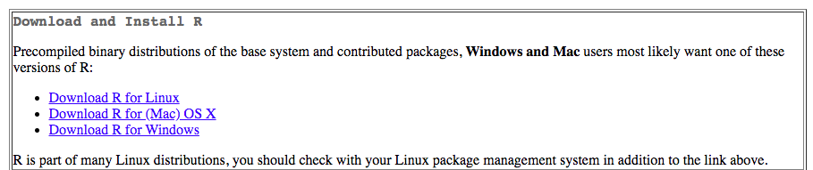
Install R
Go on this link to download R https://cran.rstudio.com/
Select the version that works for your operating system, and download the latest release (R-3.6.0).
Once you’ve downloaded R, install it following the instructions on the screen.

Slide 6
Now what?
R is a Unix based language
So, R code can be run from within Terminal.
BUT:
Your code and analyses will be MUCH cleaner, more organized, easier to debug, and more reproducible if you use RStudio, which is a widely used integrated development environment (IDE) for R.

Slide 7
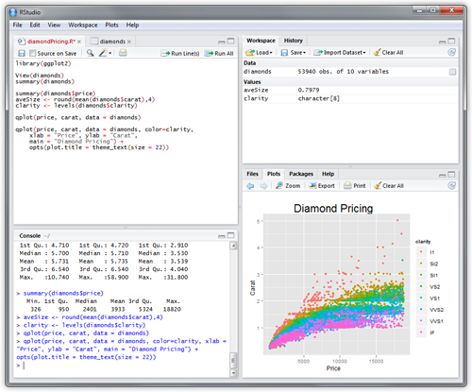

What is RStudio?
An integrated development environment for R and Python, with a console, syntax-highlighting editor that supports direct code execution, and tools for plotting, history, debugging and workspace management.

Slide 8
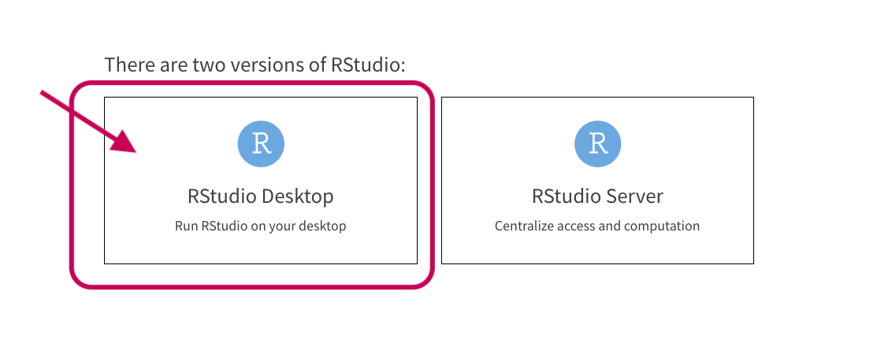
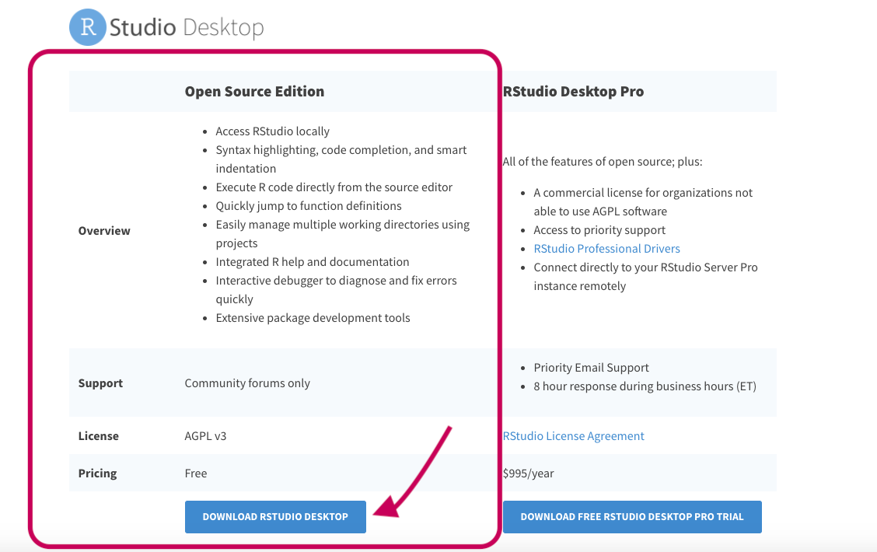
Install RStudio
Download RStudio Desktop from here: https://rstudio.com/products/rstudio/
Download the Open Source Edition:
Then install the version that is compatible
with your device.

Slide 9
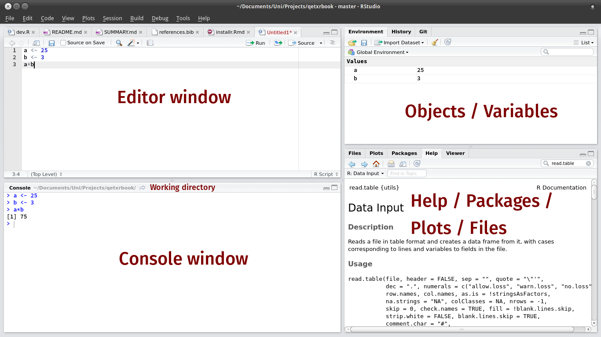
RStudio environment
https://edild.gitbooks.io/qetxrbook/content/rintro/rstudio.html

Slide 10
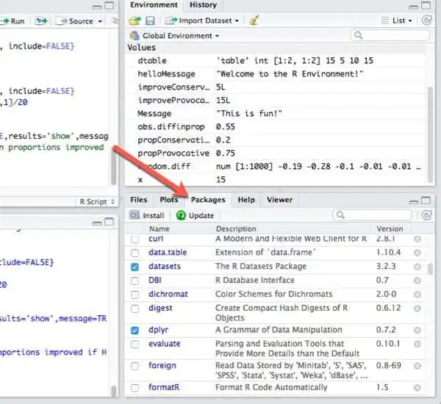
R packages
Packages extent the functionality of R. Currently, there are more the 7000 packages available on the main repository CRAN.
A few packages are already installed when you install RStudio.
To see a list of all your installed packages, go to:
The bottom right window
Click on the tab called “Packages”
You also need to load packages in every session.
The ones with a blue checkmark are loaded. The other ones are installed but not loaded.

Slide 11
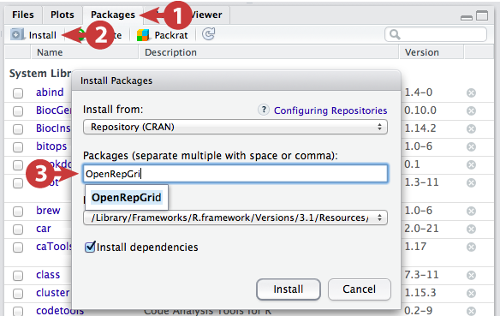
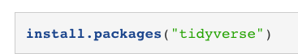
R Packages: install new packages
To install new packages, do:
Or run the code:

Slide 12

R Packages: load packages
As we mentioned, it’s not enough to install a package. You also need to load the necessary packages for your session.
To load a package, you can either click on the checkbox from the packages pane.
Or run the code:

Slide 13
RMarkdown
RMarkdown is an amazing way to have clean organized and reproducible R scripts.
You can even embed text and have your code and its outputs be printed in a neat PDF document.
Here’s a 1-minute video to give you an overview:
https://vimeo.com/178485416
Throughout the bootcamp, we’ll be using RMarkdown files to code, so you’ll get a feel for it.
https://rmarkdown.rstudio.com/lesson-1.html

